Slide 1

Programming Languages
Third Edition
Chapter 12
Formal Semantics

Slide 2
Objectives
Become familiar with a sample small language for the purpose of semantic specification
Understand operational semantics
Understand denotational semantics
Understand axiomatic semantics
Become familiar with proofs of program correctness
Programming Languages, Third Edition

Slide 3
Introduction
In previous chapters, we discussed semantics from an informal, or descriptive, point of view
  Historically, this has been the usual approach
There is a need for a more mathematical description of the behavior of programs and programming languages, to make the definition of a language so precise that:
  Programs can be proven correct in a mathematical way
  Translators can be validated to produce exactly the behavior described in the language definition
Programming Languages, Third Edition

Slide 4
Introduction (cont’d.)
Developing such a mathematical system aids the designer in discovering inconsistencies and ambiguities
There is no single accepted method for formally defining semantics
Several methods differ in the formalisms used and the kinds of intended applications
Formal semantic descriptions are more often supplied after the fact, and only for a portion of a language
Programming Languages, Third Edition

Slide 5
Introduction (cont’d.)
Formal methods have begun to be used as part of the specification of complex software projects, including language translators
Three principal methods to describe semantics formally:
  Operational semantics
  Denotational semantics
  Axiomatic semantics
Programming Languages, Third Edition

Slide 6
Introduction (cont’d.)
Operational semantics:
  Defines a language by describing its actions in terms of the operators of an actual or hypothetical machine
  Requires that the operations of the machine used in the description are also precisely defined
  A mathematical model called a “reduction machine” is often used for this purpose (similar in spirit to the notion of a Turing machine)
Programming Languages, Third Edition

Slide 7
Introduction (cont’d.)
Denotational semantics:
  Uses mathematical functions on programs and program components to specify semantics
  Programs are translated into functions about which properties can be proved using standard mathematical theory of functions
Programming Languages, Third Edition

Slide 8
Introduction (cont’d.)
Axiomatic semantics:
  Applies mathematical logic to language definition
  Assertions, or predicates, are used to describe desired outcomes and initial assumptions for program
  Language constructs are associated with predicate transforms to create new assertions out of old ones
  Transformers can be used to prove that the desired outcome follows from the initial conditions
  Is a method aimed specifically at correctness proofs
Programming Languages, Third Edition

Slide 9
Introduction (cont’d.)
All these methods are syntax-directed
  Semantic definitions are based on a context-free grammar or Backus-Naur Form (BNF) rules
Formal semantics must then define all properties of a language that are not specified by the BNF
  Includes static properties such as static types and declaration before use
Formal methods can describe both static and dynamic properties
We will view semantics as everything not specified by the BNF
Programming Languages, Third Edition

Slide 10
Introduction (cont’d.)
Two properties of a specification are essential:
  Must be complete: every correct, terminating program must have associated semantics given by the rules
  Must be consistent: the same program cannot be given two different, conflicting semantics
Additionally, it is advantageous for the semantics to be minimal, or independent
  No rule is derivable from the other rules
Programming Languages, Third Edition

Slide 11
Introduction (cont’d.)
Formal specifications written in operational or denotational style have an additional useful property:
  They can be translated relatively easily into working programs in a language suitable for prototyping, such as Prolog, ML, or Haskell
Programming Languages, Third Edition

Slide 12
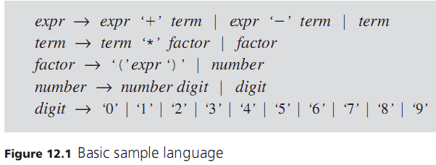
A Sample Small Language
The basic sample language to be used is a version of the integer expression language used in Ch. 6
BNF rules for this language:
Programming Languages, Third Edition

Slide 13
A Sample Small Language (cont’d.)
This results in simple semantics:
  The value of an expression is a complete representation of its meaning: 2 + 3 * 4 means 14
Complexity will now be added to this language in stages
In the first stage, we add variables, statements, and assignments
  A program is a list of statements separated by semicolons
  A statement is an assignment of an expression to an identifier
Programming Languages, Third Edition

Slide 14
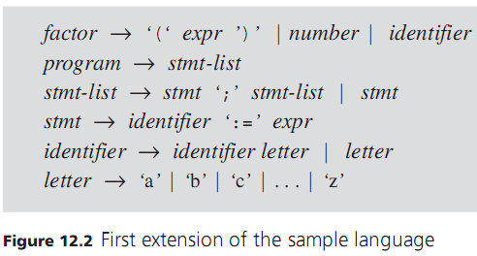
A Sample Small Language (cont’d.)
Programming Languages, Third Edition

Slide 15

A Sample Small Language (cont’d.)
Semantics are now represented by a set of values corresponding to identifiers whose values have been defined, or bound, by assignments
Example:
  Results in bindings b=20 and a=15 when it finishes
  Set of values representing the semantics of the program is {a=15, b=20}
Programming Languages, Third Edition

Slide 16
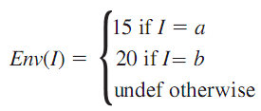
A Sample Small Language (cont’d.)
Such a set is essentially a function from identifiers to integer values, with all unassigned identifiers having a value undefined
  This function is called an environment, denoted by:
Note that the Env function given by this example program can be defined as:
Programming Languages, Third Edition

Slide 17

A Sample Small Language (cont’d.)
The operation of looking up the value of an identifier I in an environment Env is Env(I)
Empty environment is denoted by Env₀
An environment as defined here incorporates both the symbol table and state functions
Such environments:
  Do not allow pointer values
  Do not include scope information
  Do not permit aliases
Programming Languages, Third Edition

Slide 18
A Sample Small Language (cont’d.)
For this view of the semantics of a program represented by a resulting final environment:
  Consistency: we cannot derive two different final environments for the same program
  Completeness: we must be able to derive a final environment for every correct, terminating program
We now add if and while control statements
  Syntax of the if and while statements borrows the Algol68 convention of writing reserved words backward, instead of begin and end blocks
Programming Languages, Third Edition

Slide 19
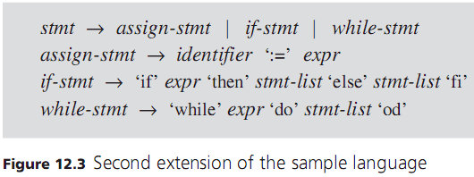
A Sample Small Language (cont’d.)
Programming Languages, Third Edition

Slide 20
A Sample Small Language (cont’d.)
Meaning of an if-stmt:
  expr is evaluated in the current environment
  If it evaluates to an integer greater than 0, then stmt-list after then is executed
  If not, stmt-list after the else is executed
Meaning of a while-stmt:
  As long as expr evaluates to a quantity greater than 0, stmt-list is repeatedly executed and expr is reevaluated
Note that these semantics are nonstandard!
Programming Languages, Third Edition

Slide 21
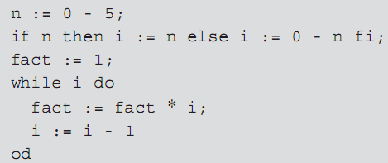
A Sample Small Language (cont’d.)
Example program in this language:
Semantics are given by the final environment:
Programming Languages, Third Edition

Slide 22
A Sample Small Language (cont’d.)
Difficult to provide semantics for loop constructs
  We will not always give a complete solution
Formal semantic methods often use a simplified version of syntax from that given
An ambiguous grammar can be used to define semantics because:
  Parsing step is assumed to have already taken place
  Semantics are defined only for syntactically correct constructs
Nonterminal symbols can be replaced by single letters
Programming Languages, Third Edition

Slide 23
A Sample Small Language (cont’d.)
Nonterminal symbols can be replaced by single letters
  May be thought to represent strings of tokens or nodes in a parse tree
Such a syntactic specification is sometimes called an abstract syntax
Programming Languages, Third Edition

Slide 24
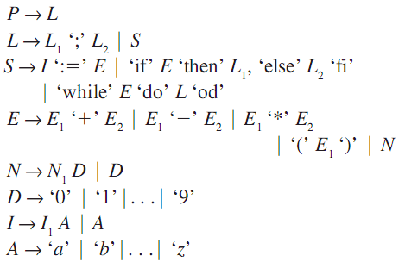
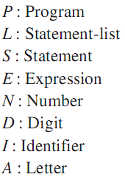
A Sample Small Language (cont’d.)
Abstract syntax for our sample language:
Programming Languages, Third Edition

Slide 25
A Sample Small Language (cont’d.)
To define the semantics of each symbol, we define the semantics of each right-hand side of the abstract syntax rules in terms of the semantics of their parts
  Thus, syntax-directed semantic definitions are recursive in nature
Tokens in the grammar are enclosed in quotation marks
Programming Languages, Third Edition

Slide 26

Operational Semantics
Operational semantics specify how an arbitrary program is to be executed on a machine whose operation is completely known
Definitional interpreters or compilers: translators for the language written in the machine code of the chosen machine
Operational semantics can define the behavior of programs in terms of an abstract machine
Programming Languages, Third Edition

Slide 27

Operational Semantics (cont’d.)
Reduction machine: an abstract machine whose control operates directly on a program to reduce it to its semantic “value”
Example: reduction of the expression (3+4)*5
To specify the operational semantics, we give reduction rules that specify how the control reduces constructs of the language to a value
Programming Languages, Third Edition

Slide 28



Logical Inference Rules
Inference rules in logic are written in the form:
  If the premise is true, the conclusion is also true
Inference rule for the commutative property of addition:
Inference rules are used to express the basic rules of prepositional and predicate calculus:
Programming Languages, Third Edition

Slide 29

Logical Inference Rules (cont’d.)
Axioms: inference rules with no premise
  They are always true
  Example:
  Axioms can be written as an inference rule with an empty premise:
  Or without the horizontal line:
Programming Languages, Third Edition

Slide 30

Reduction Rules for Integer Arithmetic Expressions
Structured operational semantics: the notational form for writing reduction rules that we will use
Semantics rules are based on the abstract syntax for expressions:
The notation states that expression E reduces to expression E1 by some reduction rule
Programming Languages, Third Edition

Slide 31

Reduction Rules for Expressions
Collect all rules for reducing digits to values in this one rule
  All are axioms
Programming Languages, Third Edition

Slide 32
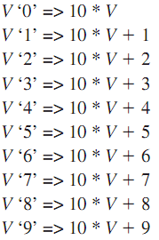
Reduction Rules for Expressions (cont’d.)
Collect all rules for reducing numbers to values in this one rule
  All are axioms
Programming Languages, Third Edition

Slide 33








Reduction Rules for Expressions (cont’d.)
Programming Languages, Third Edition

Slide 34
Reduction Rules for Expressions (cont’d.)
Rules 1 through 6 are all axioms
Rules 1 and 2 express the reduction of digits and numbers to values
  Character ‘0’ (a syntactic entity) reduces to the value 0 (a semantic entity)
Rules 3 to 5 allow an expression consisting of two values and an operator symbol to be reduced to a value by applying the appropriate operation whose symbol appears in the expression
Rule 6 says parentheses around an expression can be dropped
Programming Languages, Third Edition

Slide 35
Reduction Rules for Expressions (cont’d.)
The rest of the reduction rules are inferences that allow the reduction machine to combine separate reductions together to achieve further reductions
Rule 14 expresses the general fact that reductions can be performed stepwise (sometimes called the transitivity rule for reductions)
Programming Languages, Third Edition

Slide 36

Reduction Rules for Expressions (cont’d.)
Applying these reduction rules to the expression:
First reduce the expression: 3 + 4:
Thus, by rule 14, we have:
Programming Languages, Third Edition

Slide 37



Reduction Rules for Expressions (cont’d.)
Continuing:
Now reduce the expression 2*(3+4) as follows:
And finally:
Programming Languages, Third Edition

Slide 38
Environments and Assignment
Abstract syntax for our sample language:
Programming Languages, Third Edition

Slide 39
Environments and Assignment (cont’d.)
We want to extend the operational semantics to include environments and assignments
Must include the effect of assignments on the storage of the abstract machine
Our view of storage: an environment that is a function from identifiers to integer values (including the undefined value):
The notation indicates that expression E is evaluated in the presence of environment Env
Programming Languages, Third Edition

Slide 40

Environments and Assignment (cont’d.)
Now our reduction rules change to include environments
Example: rule 7 with environments becomes:
  This states that if E reduces to E1 in the presence of Env, then E ‘+’ E2 reduces to E1 ‘+’ E2 in the same environment
Programming Languages, Third Edition

Slide 41

Environments and Assignment (cont’d.)
The one case of evaluation that explicitly involves the environment is when an expression is an identifier I, giving a new rule:
    This states that if the value of identifier I is V in Env, then I reduces to V in the presence of Env
Next, we add assignment statements and statement sequences to the reduction rules
Programming Languages, Third Edition

Slide 42

Environments and Assignment (cont’d.)
Statements must reduce to environments instead of integer values, since they create and change environments, giving this rule:
  This states that the assignment of the value V to I in Env reduces to a new environment where I is equal to V
Reduction of expressions within assignments uses this rule:
Programming Languages, Third Edition

Slide 43

Environments and Assignment (cont’d.)
A statement sequence reduces to an environment formed by accumulating the effect of each assignment, giving this rule:
Finally, a program is a statement sequence with no prior environment, giving this rule:
  It reduces to the effect it has on the empty starting environment
Programming Languages, Third Edition

Slide 44

Environments and Assignment (cont’d.)
Rules for reducing identifier expressions are completely analogous to those for reducing numbers
Sample program to be reduced to an environment:
To simplify the reduction, we will suppress the use of quotes to differentiate between syntactic and semantic entities
Programming Languages, Third Edition

Slide 45



Environments and Assignment (cont’d.)
First, by rule 19, we have:
Also, by rules 3, 17, and 16:
Then by rule 18:
Programming Languages, Third Edition

Slide 46


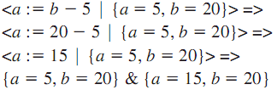
Environments and Assignment (cont’d.)
Similarly, by rules 15, 9, 5, 17, and 16:
Then by rule 18 :
Finally, by a similar application of rules:
Programming Languages, Third Edition

Slide 47

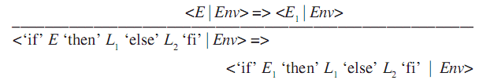
Control
Next we add if and while statements, with this abstract syntax:
Reduction rules for if statements include:
Programming Languages, Third Edition

Slide 48




Control (cont’d.)
Reduction rules for while statements include:
Programming Languages, Third Edition

Slide 49
Implementing Operational Semantics in a Programming Language
It is possible to implement operational semantic rules directly as a program to get an executable specification
This is useful for two reasons:
  Allows us to construct a language interpreter directly from a formal specification
  Allows us to check the correctness of the specification by testing the resulting interpreter
A possible Prolog implementation for the reduction rules of our sample language will be used
Programming Languages, Third Edition

Slide 50

Implementing Operational Semantics in a Programming Language (cont’d.)
Example: 3*(4+5) in Prolog:
Example: this program:
  Can be represented in Prolog as:
This is actually a tree representation, and no parentheses are necessary to express grouping
Programming Languages, Third Edition

Slide 51
Implementing Operational Semantics in a Programming Language (cont’d.)
We can write reduction rules (ignoring environment rules for the moment)
A general reduction rule for expressions:
  Where X is any arithmetic expression (in abstract syntax) and Y is the result of a single reduction step applied to X
Example:
  Rule 3 can be written as:
Programming Languages, Third Edition

Slide 52

Implementing Operational Semantics in a Programming Language (cont’d.)
Rule 7 becomes:
Rule 10 becomes:
Rule 14 presents a problem if written as:
  Infinite recursive loops will result
Instead, write rule 14 as two rules:
Programming Languages, Third Edition

Slide 53
Implementing Operational Semantics in a Programming Language (cont’d.)
Now extend to environments and control: a pair <E|Env> can be thought of as a configuration and written in Prolog as config(E,Env)
Rule 15 then becomes:
  Where atom(I) tests for a variable and lookup operation finds values in an environment
Programming Languages, Third Edition

Slide 54
Implementing Operational Semantics in a Programming Language (cont’d.)
Rule 16 becomes:
  Where update inserts the new value V for I into Env, yielding Env1
Any dictionary structure for which lookup and update can be defined can be used to represent an environment in this code
Programming Languages, Third Edition

Slide 55
Denotational Semantics
Denotational semantics use functions to describe the semantics of a programming language
  A function associates semantic values to syntactically correct constructs
Example: a function that maps an integer arithmetic expression to its value:
  Syntactic domain: domain of a semantic function
  Semantic domain: range of a semantic function, which is a mathematical structure
Programming Languages, Third Edition

Slide 56
Denotational Semantics (cont’d.)
Example: val(2+3*4) = 14
  Set of integers is the semantic domain
  val maps the syntactic construct 2+3*4 to the semantic value 14; it denotes the value 14
A program can be viewed as something that receives input and produces output
Its semantics can be represented by a function:
  Semantic domain is a set of functions from input to output
  Semantic value is a function
Programming Languages, Third Edition

Slide 57
Denotational Semantics (cont’d.)
Since semantic domains are often functional domains, and values of semantic functions will be functions themselves, we will assume the symbol “→” is right associative and drop the parentheses:
Three parts of a denotational definition of a program:
  Definition of the syntactic domains
  Definition of the semantic domains
  Definition of the semantic functions themselves (sometimes called valuation functions)
Programming Languages, Third Edition

Slide 58
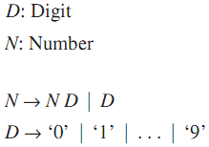
Syntactic Domains
Syntactic domains:
  Are defined in denotational definition using notation similar to abstract syntax
  Are viewed as sets of syntax trees whose structure is given by grammar rules that recursively define elements of the set
Example:
Programming Languages, Third Edition

Slide 59
Semantic Domains
Semantic domains: sets in which semantic functions take their values
  Like syntactic domains but may also have additional mathematical structure, depending on use
Example: integers have arithmetic operations
Such domains are algebras, which are specified by listing their functions and properties
  Denotational definition of semantic domains lists the sets and operations but usually omits the properties of the operations
Programming Languages, Third Edition

Slide 60
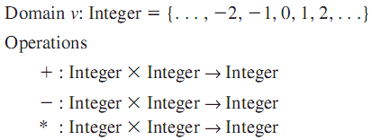
Semantic Domains (cont’d.)
Domains sometimes need special mathematical structures that are the subject of domain theory
  Term domain is sometimes reserved for an algebra with the structure of a complete partial order
  This structure is needed to define the semantics of recursive functions and loops
Example: semantic domain of the integers:
Programming Languages, Third Edition

Slide 61
Semantic Functions
Semantic function: specified for each syntactic domain
Each function is given a different name based on its associated syntactic domain, usually with boldface letters
Example: value function from the syntactic domain Digit to the integers:
Programming Languages, Third Edition

Slide 62

Semantic Functions (cont’d.)
Value of a semantic function is specified recursively on the trees of syntactic domains using the structure of grammar rules
Semantic equation corresponding to each grammar rule is given
Example: grammar rule for digits:
  Gives rise to syntax tree nodes:
Programming Languages, Third Edition

Slide 63

Semantic Functions (cont’d.)
Example (cont’d.):
  Semantic function D is defined by these semantic equations representing the value of each leaf:
  This notation is shorted to the following:
  Double brackets [[…]] indicate that the argument is a syntactic entity consisting of a syntax tree node with the listed arguments as children
Programming Languages, Third Edition

Slide 64


Semantic Functions (cont’d.)
Example: semantic function from numbers to integers:
  Is based on the syntax:
  And is given by these equations:
  Where [[ND]] refers to the tree node
  And [[D]] refers to the node
Programming Languages, Third Edition

Slide 65
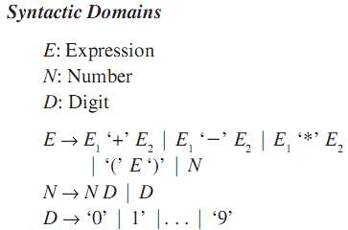
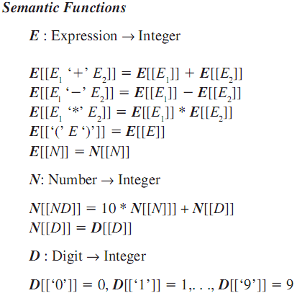
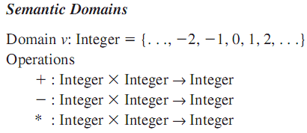
Denotational Semantics of Integer Arithmetic Expressions
Programming Languages, Third Edition

Slide 66
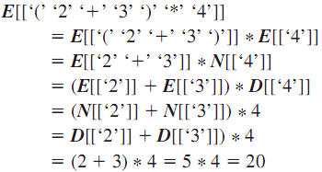
Denotational Semantics of Integer Arithmetic Expressions (cont’d.)
Using these equations to obtain the semantic value of an expression, we compute or more precisely,
Programming Languages, Third Edition

Slide 67
Environments and Assignments
First extension to our sample language adds identifiers, assignment statements, and environments
Environments are functions from identifiers to integers (or undefined)
Set of environments becomes a new semantic domain:
Programming Languages, Third Edition

Slide 68

Environments and Assignments (cont’d.)
In denotational semantics, the value undef is called bottom, from the theory of partial orders, and is denoted by the symbol
Semantic domains with this value are called lifted domains and are subscripted with the symbol
The initial environment defined previously can now be defined as:
Semantic value of an expression becomes a function from environments to integers:
Programming Languages, Third Edition

Slide 69
Environments and Assignments (cont’d.)
The value of an identifier is its value in the environment provided as a parameter:
For a number, the environment is immaterial:
For statements and statement lists, the semantic values are functions from environments to environments
  The “&” notation is used to add values to functions that we have used in previous sections
Programming Languages, Third Edition

Slide 70
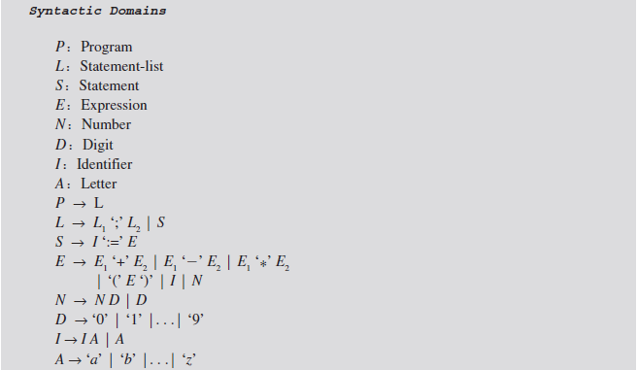
Programming Languages, Third Edition

Slide 71
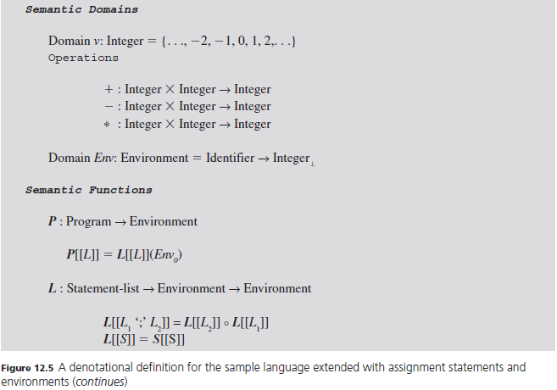
Programming Languages, Third Edition

Slide 72
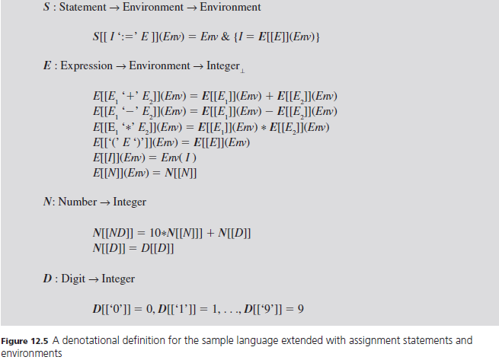
Programming Languages, Third Edition

Slide 73


Denotational Semantics of Control Statements
if and while statements have this abstract syntax:
Denotational semantics is given by a function from environments to environments:
Semantic function of the if statement:
Programming Languages, Third Edition

Slide 74
Denotational Semantics of Control Statements (cont’d.)
Semantic function for the while statement is more difficult
  Can construct a function as a set by successively extending it to a least-fixed-point solution, the “smallest” solution satisfying the equation
  Here, F will be a function on the semantic domain of environments
Must also deal with nontermination in loops by assigning the “undefined” value
Programming Languages, Third Edition

Slide 75
Denotational Semantics of Control Statements (cont’d.)
The domain of environments becomes a lifted domain:
Semantic function for statements is defined as:
Programming Languages, Third Edition

Slide 76
Implementing Denotational Semantics in a Programming Language
We will use Haskell for a possible implementation of the denotational functions of the sample language
Abstract syntax of expressions:
We ignore the semantics of numbers and simply let values be integers
Programming Languages, Third Edition

Slide 77
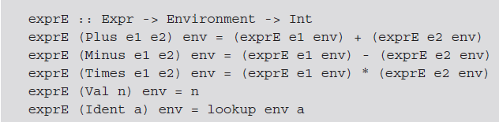
Implementing Denotational Semantics in a Programming Language (cont’d.)
Assume we have defined an Environment type with a lookup and update operation
The E evaluation function can be defined as:
Programming Languages, Third Edition

Slide 78
Axiomatic Semantics
Axiomatic semantics: define the semantics of a program, statement, or language construct by describing the effect its execution has on assertions about the data manipulated by the program
Elements of mathematical logic are used to specify the semantics, including logical axioms
We consider logical assertions to be statements about the behavior of the program that are true or false at any moment during execution
Programming Languages, Third Edition

Slide 79

Axiomatic Semantics (cont’d.)
Preconditions: assertions about the situation just before execution
Postconditions: assertions about the situation just after execution
Standard notation is to write the precondition inside curly brackets just before the construct and write the postcondition similarly just after the construct:
or
Programming Languages, Third Edition

Slide 80

Axiomatic Semantics (cont’d.)
Example:
  Semantics become:
Such pre- and postconditions are often capable of being tested for validity during execution, as a kind of error checking
  Conditions are usually Boolean expressions
In C, can use the assert.h macro library for checking assertions
Programming Languages, Third Edition

Slide 81
Axiomatic Semantics (cont’d.)
An axiomatic specification of the semantics of the language construct C is of the form
  Where P and Q are assertions
  If P is true just before execution of C, then Q is true just after execution of C
This representation of the action of C is not unique and may not completely specify all actions of C
Goal-oriented activity: way to associate to C a general relation between precondition P and postcondition Q
  Work backward from the goal to the requirements
Programming Languages, Third Edition

Slide 82

Axiomatic Semantics (cont’d.)
There is one precondition P that is the most general or weakest assertion with the property that
  Called the weakest precondition of postcondition Q and construct C
  Written as
Can now restate the property as
Programming Languages, Third Edition

Slide 83
Axiomatic Semantics (cont’d.)
We define the axiomatic semantics of language construct C as the function from assertion to assertion
  Called a predicate transformer: takes a predicate as argument and returns a predicate result
  Computes the weakest precondition from any postcondition
Example assignment can now be restated as:
Programming Languages, Third Edition

Slide 84

General Properties of wp
Predicate transformer has certain properties that are true for almost all language constructs C
Law of the Excluded Miracle:
  There is nothing a construct C can do that will make false into true
Distributivity of Conjunction:
Law of Monotonicity:
Programming Languages, Third Edition

Slide 85
General Properties of wp (cont’d.)
Distributivity of Disjunction:
The last two properties regard implication operator “→” and “or” operator with equality if C is deterministic
The question of determinism adds complexity
  Care must be taken when talking about any language construct
Programming Languages, Third Edition

Slide 86
Axiomatic Semantics of the Sample Language
The specification of the semantics of expressions alone is not commonly included in an axiomatic specification
Assertions in an axiomatic specificator are primarily statements about the side effects of constructs
  They are statements involving identifiers and environments
Programming Languages, Third Edition

Slide 87
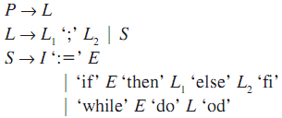
Axiomatic Semantics of the Sample Language (cont’d.)
Abstract syntax for which we will define the wp operator:
The first two rules do not need separate specifications
  The wp operator for program P is the same as for its associated statement-list L
Programming Languages, Third Edition

Slide 88
Axiomatic Semantics of the Sample Language (cont’d.)
Statement-lists: for lists of statements separated by a semicolon, we have:
  The weakest precondition of a series of statements is the composition of the weakest preconditions of its parts
Assignment statements: definition of wp is:
  is the assertion Q, with E replacing all free occurrences of the identifier I in Q
Programming Languages, Third Edition

Slide 89

Axiomatic Semantics of the Sample Language (cont’d.)
Recall that an identifier I is free in a logical assertion Q if it is not bound by either the existential quantifier “there exists” or the universal quantifier “for all”
says that for Q to be true after the assignment I:=E, whatever Q says about I must be true about E before the assignment is executed
If statements: our semantics of the if statement state that the expression is true if it is greater than 0 and false otherwise
Programming Languages, Third Edition

Slide 90

Axiomatic Semantics of the Sample Language (cont’d.)
Given the if statement:
The weakest precondition is defined as:
While statements: executes as long as E>0
Must give an inductive definition based on the number of times the loop executes
Let be a statement that the loop executes I times and terminates satisfying Q
Programming Languages, Third Edition

Slide 91



Axiomatic Semantics of the Sample Language (cont’d.)
Then
And
Continuing, we have in general that:
Now we define:
Programming Languages, Third Edition

Slide 92
Axiomatic Semantics of the Sample Language (cont’d.)
Note that this definition of the semantics of the while requires that the loop terminates
A non-terminating loop always has false as its weakest precondition (it can never make a postcondition true)
These semantics for loops are difficult to use in the area of proving correctness of programs
Programming Languages, Third Edition

Slide 93
Proofs of Program Correctness
The major application of axiomatic semantics is as a tool for proving correctness of programs
Recall that C satisfies a specification provided
To prove correctness:
  Compute wp from the axiomatic semantics and general properties of wp
  Show that
Programming Languages, Third Edition

Slide 94
Proofs of Program Correctness (cont’d.)
To show that a while-statement is correct, we only need an approximation of its weakest precondition, that is some assertion W such that
If we can show that P→W, we have also shown the correctness of {P} while… {Q}, since P→W and W→wp(while…,Q) imply that P→wp(while…,Q)
Programming Languages, Third Edition

Slide 95

Proofs of Program Correctness (cont’d.)
Given the loop we need to find an assertion W such that these conditions are true:
  Every time the loop executes, W continues to be true by condition (a)
  When the loop terminates, (b) says Q must be true
  (c) implies that W is the required approximation for
Programming Languages, Third Edition

Slide 96
Proofs of Program Correctness (cont’d.)
An assertion W satisfying condition (a) is called a loop invariant for the loop, since a repetition of the loop leaves W true
  In general, loops have many invariants W
  Must find an appropriate W that also satisfies conditions (b) and (c)
Programming Languages, Third Edition

